Slide 1
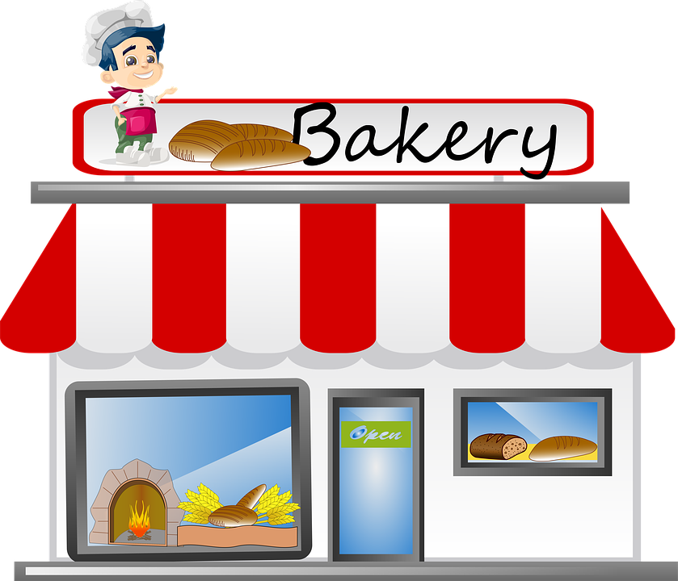



THE BAKERY
ℱ1000
This Photo by Unknown Author is licensed under CC BY-NC

Slide 2

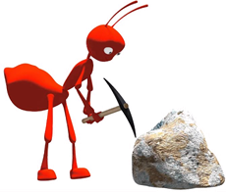









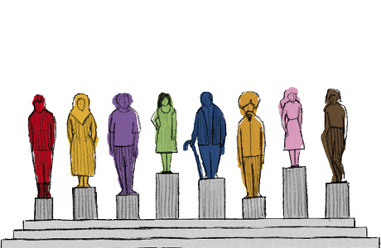

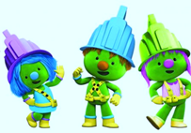
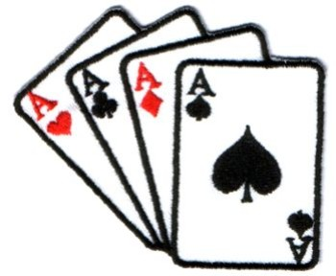






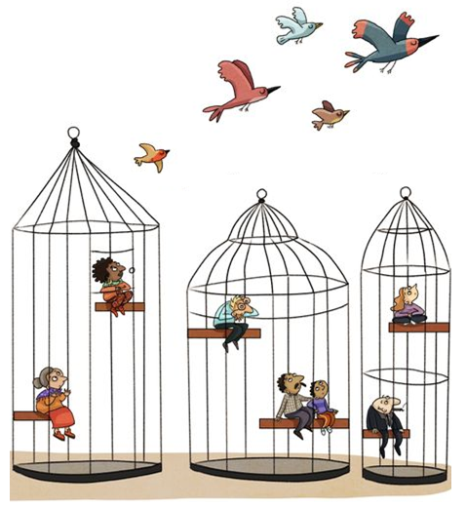
GENESIS
N.Y.B.E CryptoNext
Ant Force One
Remainers
From The Hashes
DecentraLife
Coinbridge
College
EXCHANGE
MINING FARM
GAME
BIO TECH
EDUCATION
COVID-19
The Grand
TezAAr
Pudding King
The Health Chain
World Wide
Money
Wealth Share
MARKETPLACE
BAKERY
BIO TECH
FIN TECH
SOCIAL
CHANCE
CHANCE
The 12
DOOZERS ARMY
Planet
of the Aces
Citizen Chain
Crypto On Chip
MINING FARM
GAME
LAW TECH
HW WALLET
COMMUNITY
CHEST
COMMUNITY
CHEST
Boiler Room
Privacy Connect
Smart Court
QUARANTINE
JUST VISITING
BAKERY
SOCIAL
LAW TECH
This Photo by Unknown Author is licensed under CC BY
This Photo by Unknown Author is licensed under CC BY
This Photo by Unknown Author is licensed under CC BY

Slide 3



C
r
y
p
t
D
e
F
i
P
o
L
y
ℱanta ia
ℱ
ℱ
ℱ
ℱ
ℱ
ℱ
ℱ
POWERED BY:
100
ℱ
100
100
100

Slide 4




C
r
y
p
t
POWERED BY:

Slide 5



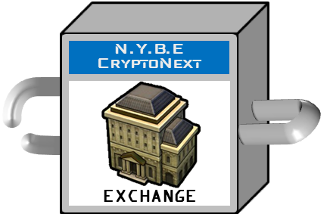
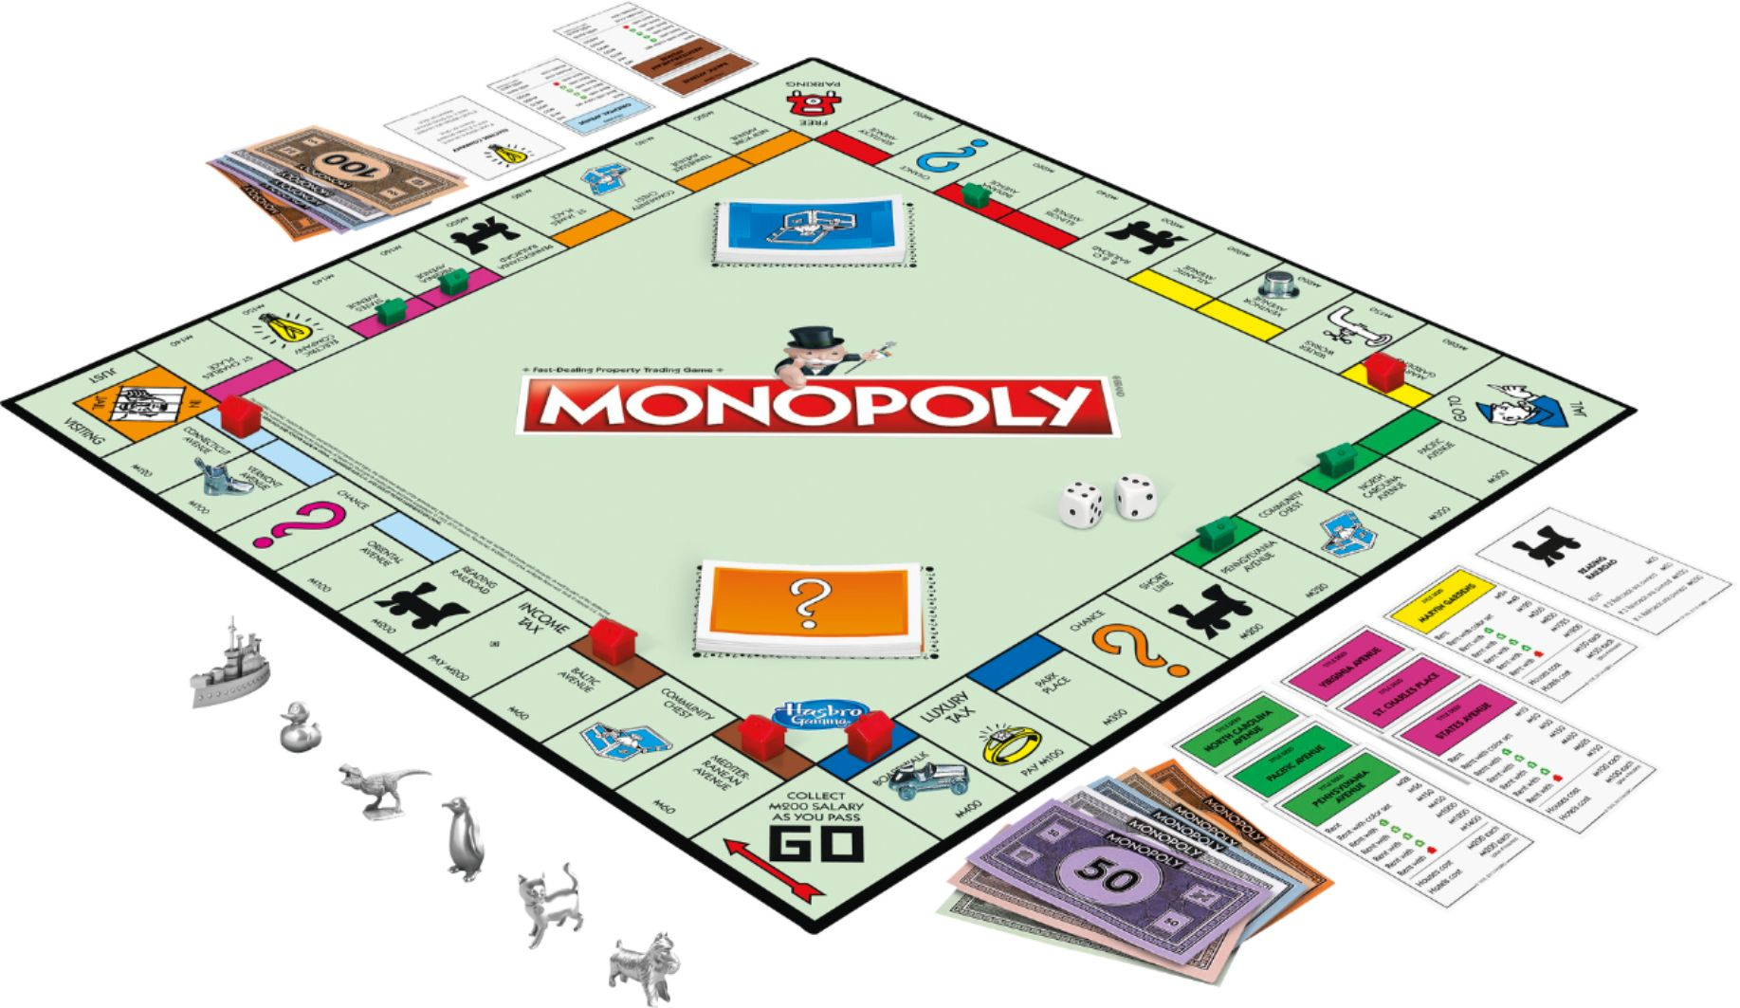








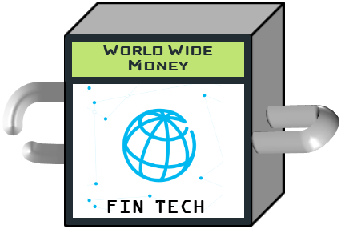
ℱanta ia
C
ℱ

Slide 7




Ant Force One
MINING FARM

Slide 9



Crypto Fantasia
The funniest to way to discover Crypto-economics
Decentralized Finance
#DeFi
POWERED BY

Slide 10
LawTech
BioTech
FinTech
EdTech
Gaming
Crypto
StarTech
CyberSec
GreenTech
Social Media

Slide 11
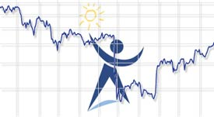
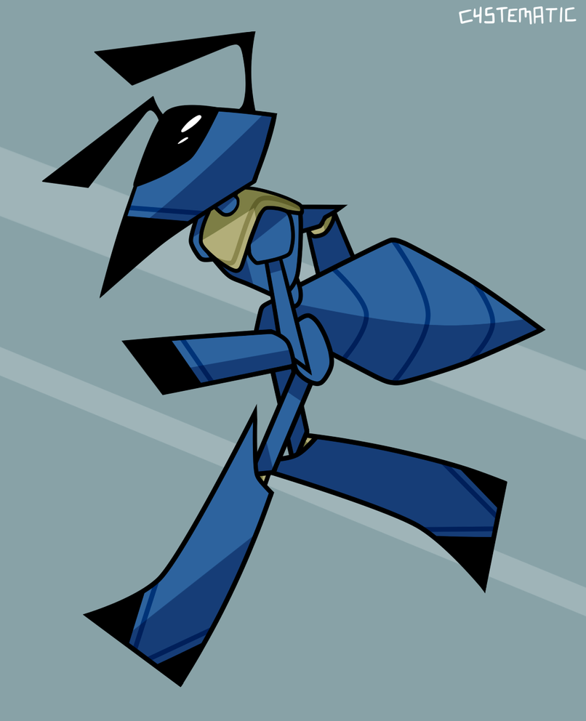


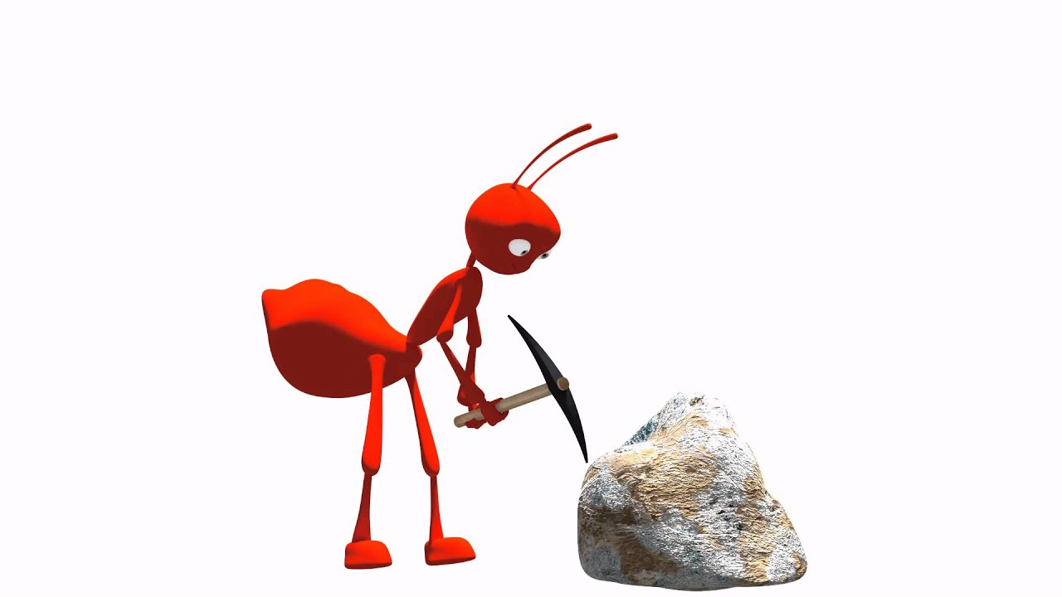



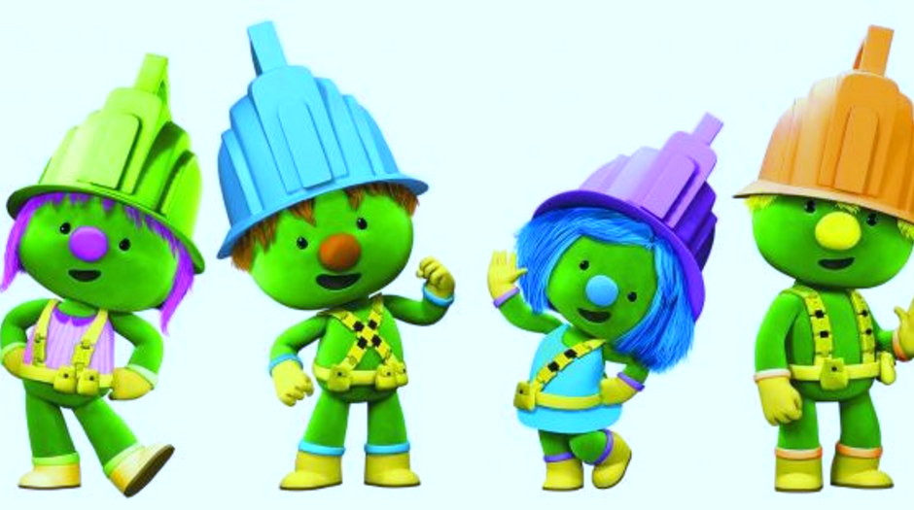
?
This Photo by Unknown Author is licensed under CC BY
This Photo by Unknown Author is licensed under CC BY
PUDDING
KING

Slide 12





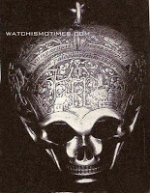
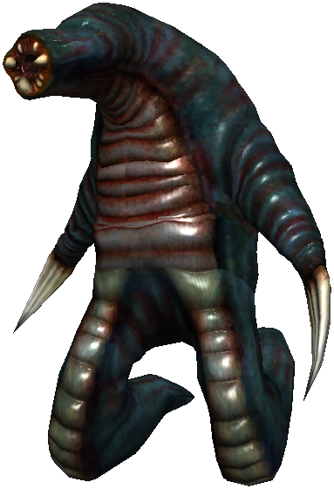
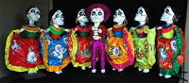


This Photo by Unknown Author is licensed under CC BY-NC-ND
This Photo by Unknown Author is licensed under CC BY-SA
This Photo by Unknown Author is licensed under CC BY-SA
This Photo by Unknown Author is licensed under CC BY
This Photo by Unknown Author is licensed under CC BY

Slide 13

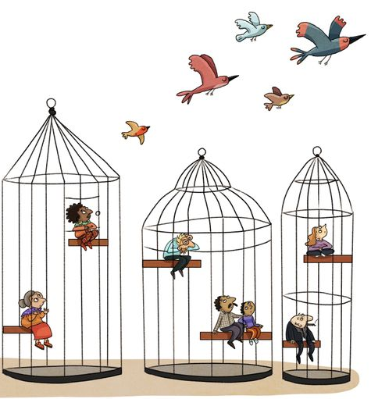



This Photo by Unknown Author is licensed under CC BY-NC

Slide 14



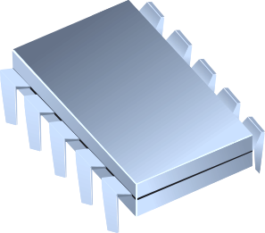



Slide 15
Found A Crypto Startup
Invoke Your Community Chest
Mine And Get Rewards
Stake And Get Rewards
Invest In Your Products
Run A Token Exchange
Launch An ICO
Took A Chance !
Run An NFT Marketplace
Buy/Sell Crypto-Assets

